Slide 1

Deloitte Pre Hire Training 2017
FOUNDATION TRAINING
Spring MVC

Slide 2
Spring 3 MVC
Tags

Slide 3
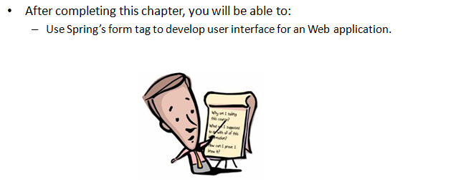
Objectives

Slide 4
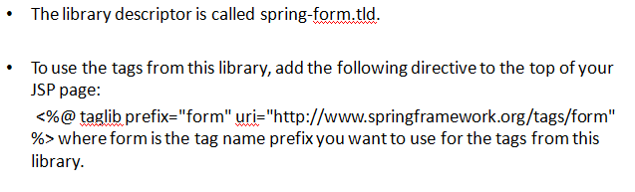
Configuration

Slide 5
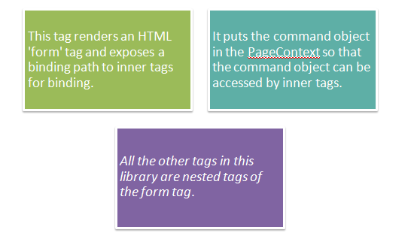
The form tag

Slide 6
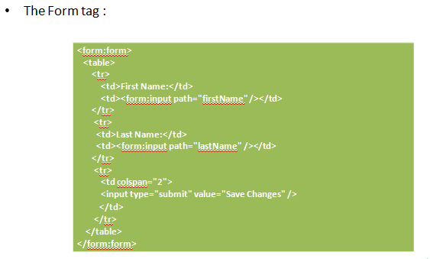
The form tag : Example

Slide 7
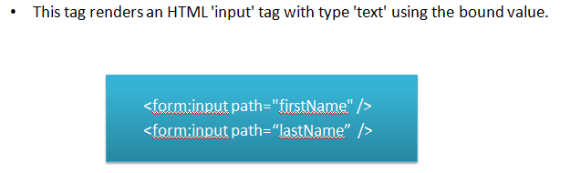
Tag Example : textbox

Slide 8
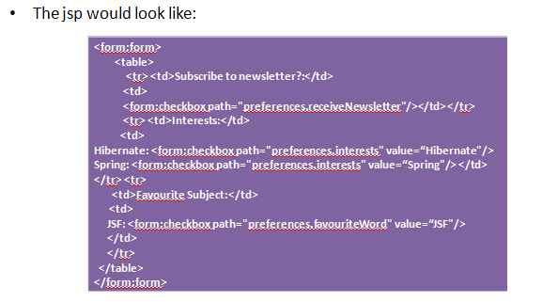
Tag Example : checkbox

Slide 9
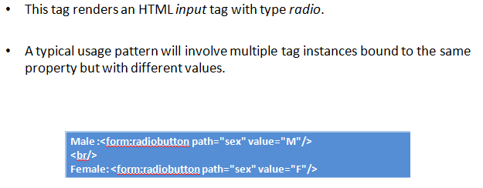
Tag Example : Radiobutton

Slide 10
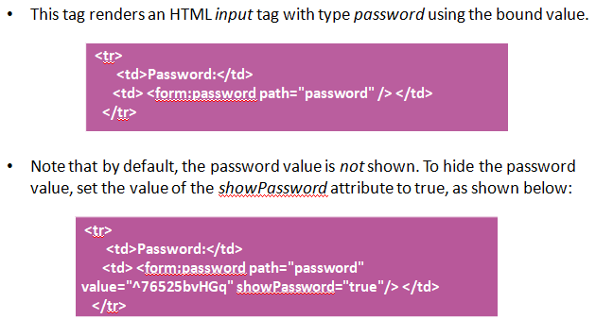

Slide 11
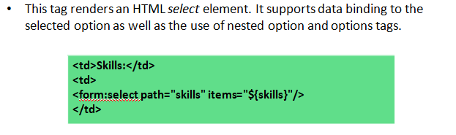
Tag Example : Select

Slide 12
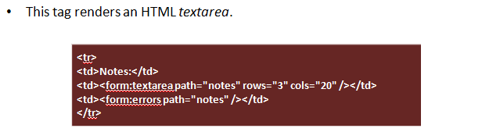
Tag Example : Textarea

Slide 13
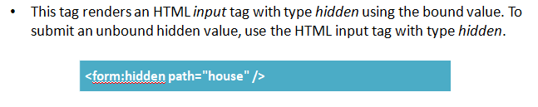
Tag Example : Hidden

Slide 14
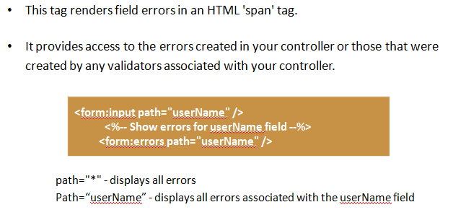
Tag Example : Errors Tag

Slide 15
Demo
Code demo for each and every tag

Slide 16
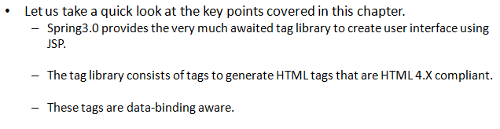
Summary

